Slide 1
Gold Sponsor

Slide 2
Bronze Sponsor

Slide 3
Silver Sponsor

Slide 4
Silver Sponsor
Brit d’Arbeloff

Slide 5
Silver Sponsor

Slide 6
Silver Sponsor

Slide 7
Silver Sponsor
Mr. & Mrs. George B Bennett

Slide 8
Silver Sponsor

Slide 9
Silver Sponsor
Donald & Patricia Hillman

Slide 10
Silver Sponsor
Nancy & Richard Friedman

Slide 11
Silver Sponsor
John & Annie Hall

Slide 12
Silver Sponsor
Dr. & Mrs. Gary P. Kearney

Slide 13
Silver Sponsor
The Honorable Paul G. Kirk, Jr.

Slide 14
Bronze Sponsor
Joel B. Alvord

Slide 15
Bronze Sponsor

Slide 16
Bronze Sponsor
Martha & Charles Clapp

Slide 17
Bronze Sponsor
Nancy & Laury
Coolidge

Slide 18
Bronze Sponsor
Sally Hinkle

Slide 19
Bronze Sponsor
Biddy & Bob Owens

Slide 20
Bronze Sponsor
Lise & Myles Striar

Slide 21
Bronze Sponsor
Paula & Samuel Thier

Slide 23
Bronze Sponsor

Slide 24
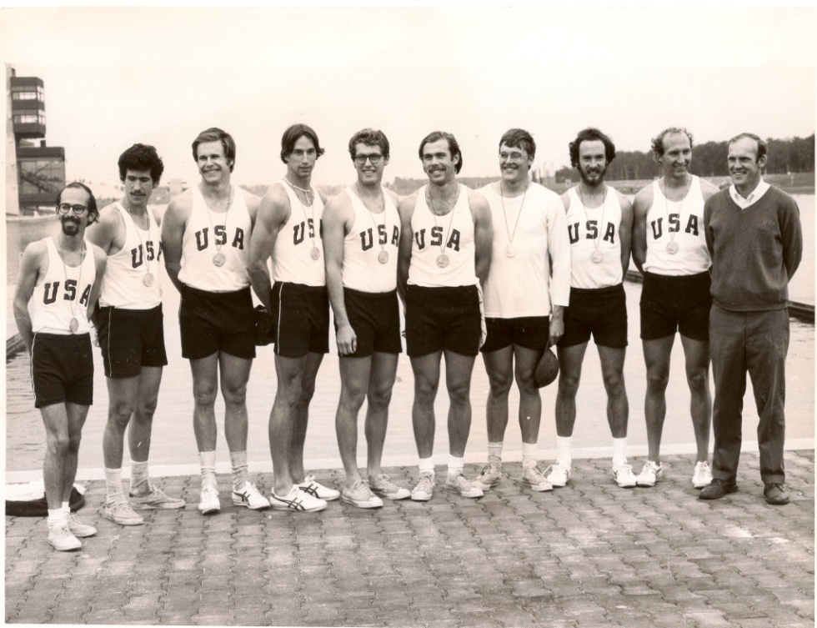
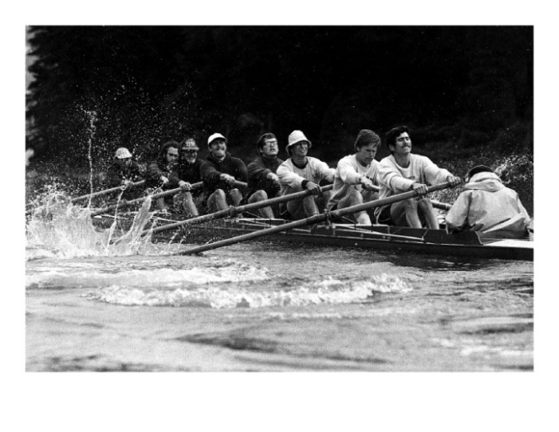
Gene + Meredith = Gold!
Congratulations from the Alte Achter Boat Club

Slide 25
Congratulations Meredith & Gene Clapp

Slide 26
Bronze Sponsor
Judy & Chia-Ming Sze

Slide 27
Bronze Sponsor
Adrienne & John Cupples

Slide 28
Bronze Sponsor
Paula O’Keeffe

Slide 29
Gold Sponsor

Slide 30
Silver Sponsor

Slide 31
Silver Sponsor
Gene & Lloyd Dahmen

Slide 32
With appreciation and thanks to Meredith and Gene for all that you have done for Rogerson Communities and the community.
Gene & Lloyd Dahmen

Slide 33
Silver Sponsor
Brit d’Arbeloff

Slide 34
Silver Sponsor
Nonnie & Rick Burnes

Slide 35
Silver Sponsor
Hal Carroll

Slide 36
Silver Sponsor
Meredith & Gene Clapp

Slide 37
Bronze Sponsor
Martha & Charles Clapp

Slide 38
Bronze Sponsor
Nancy & Laury
Coolidge

Slide 39
We are proud to join Rogerson Communities in honoring Meredith & Gene Clapp for their years of community service. Broderick & Bancroft
313 Washington Street, Suite 207
Newton, MA 02458

Slide 41
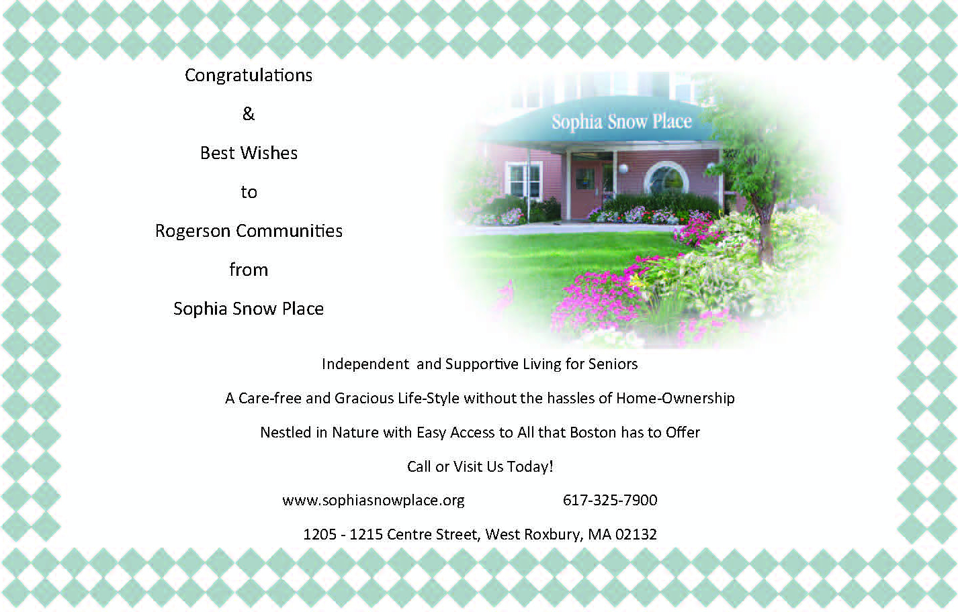
Bronze Sponsor

Slide 43
Bronze Sponsor
Ann & John Hall

Slide 45
Bronze Sponsor
Patricia & Don Hillman

Slide 46
Bronze Sponsor

Slide 47
R O G E R S O N C O M M U N I T I E S
Dear Friends,
On behalf of the Rogerson Communities Board of Directors, I congratulate Meredith and Gene Clapp are they are honored tonight with the Charles E. Rogerson Award for Community Service.
I would also like to extend our deepest gratitude to tonight’s sponsors, supporters, and attendees.
Many Thanks,
Brit d’Arbeloff
Board Chair

Slide 48
Media Sponsor

Slide 49
Bronze Sponsor

Slide 51
Bronze Sponsor
Barbara & Amos Hostetter

Slide 54
Congratulations Meredith & Gene Clapp

